Slide 1
909 transformer using voltage regulator circuit
Mohamed Imran s
VISHNUVEL R
NAVANEETHA KUMAR LS

Slide 2
ABSTRACT
A 909 transformer, in conjunction with a voltage regulator circuit, forms a vital component in electrical systems. This transformer serves to convert alternating current (AC) voltage to a specific, stable output voltage level, ensuring consistent power supply. The voltage regulator circuit ensures precision in voltage control, maintaining a constant output voltage despite fluctuations in the input voltage. This abstract highlights the crucial role of the 909 transformer and voltage regulator circuit in enhancing electrical system reliability and performance. By effectively stabilizing voltage, these components contribute to the safe and efficient operation of various electronic devices and systems, from industrial machinery to consumer electronics.

Slide 3
Components USED
9 0 9 stepdown transformer
Bridge rectifier
50v 2 x 470uf capacitor
100v capacitor
6.8k resistor
1k resistor
12v zener diode
Mini volt meter

Slide 4
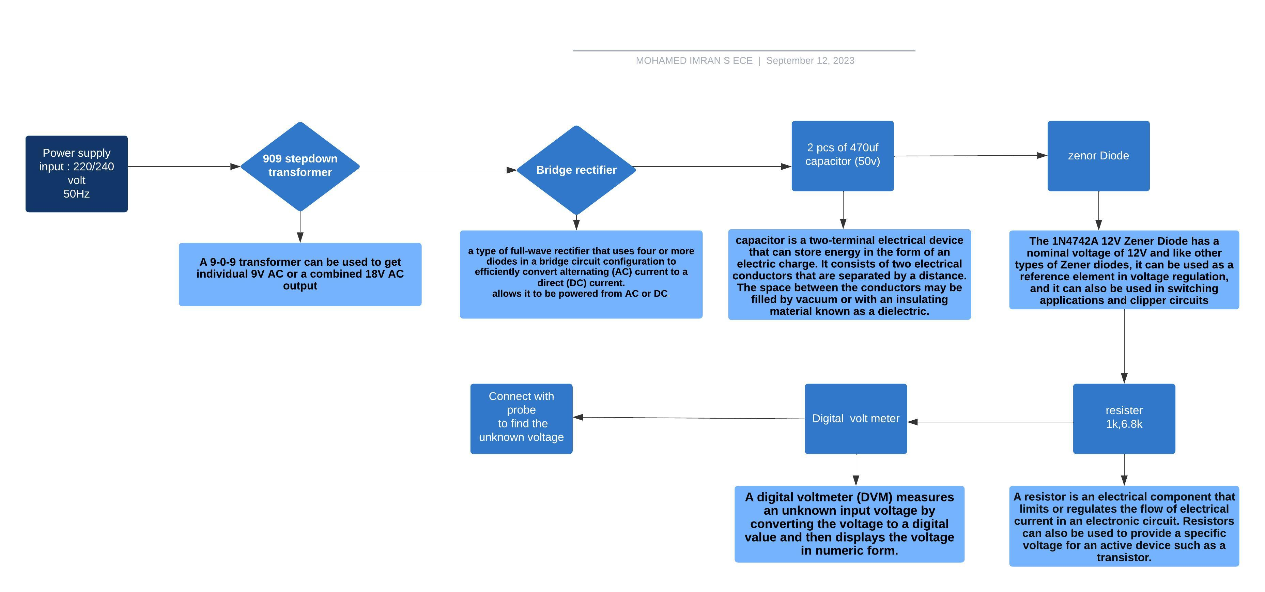
Process flow chart :

Slide 5
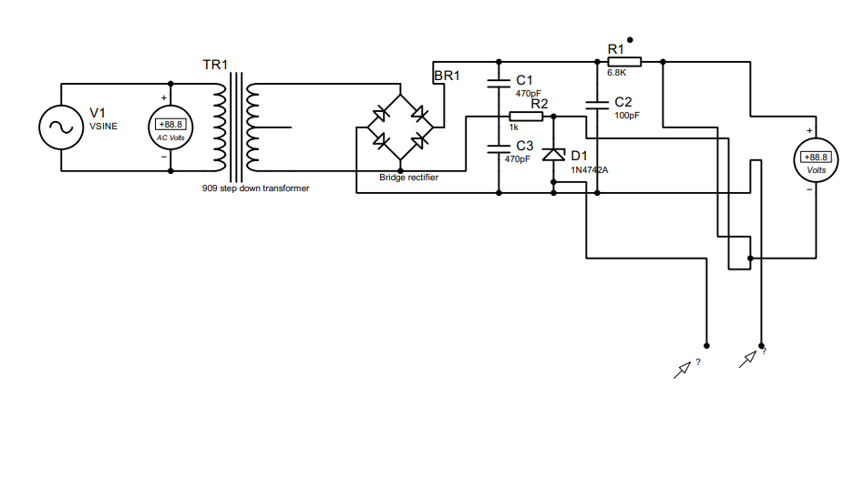
CIRCUIT DIAGRAM:

Slide 6
How IT WORKS
Voltage Step-Down: The 909 transformer initially steps down the input voltage from a higher level to a lower, more manageable voltage level, typically suited for the target application.
AC to DC Conversion: The transformer operates on alternating current (AC), which is widely used in electrical systems. It utilizes electromagnetic principles to induce voltage changes across its coils, transferring power from the primary winding to the secondary winding.
I've used a 9 0 9 stepdown transformer to make an output voltage of around 47v.

Slide 7
Applications
To find a unknown voltage of a circuit
To Check the components working or not.
Switched-Mode Power Supply/ Switching Mode Power Supply
It acts as SMPS.
An electronic power supply uses a switching regulator to convert electrical power efficiently.

